Slide 1
PyCon Canada 2016 Presentation
Quantifying the visual structure of written language
by Nick Anderegg
This work is licensed under the
Creative Commons Attribution-NonCommercial-ShareAlike 4.0 International License.
To view a copy of this license, visit http://creativecommons.org/licenses/by-nc-sa/4.0/.

Slide 2
Quantifying the visual structure of written language
Nick Anderegg

Slide 3

Outline
Background | My Research | Motivation | Algorithm | Thoughts
Research background
My research
Computational motivation
Algorithm
Take-aways

Slide 4
Background
Background | My Research | Motivation | Algorithm | Thoughts

Slide 5
Why study reading?
Background | My Research | Motivation | Algorithm | Thoughts
Understand reading disabilities
Improve natural language processing
It’s interesting

Slide 6
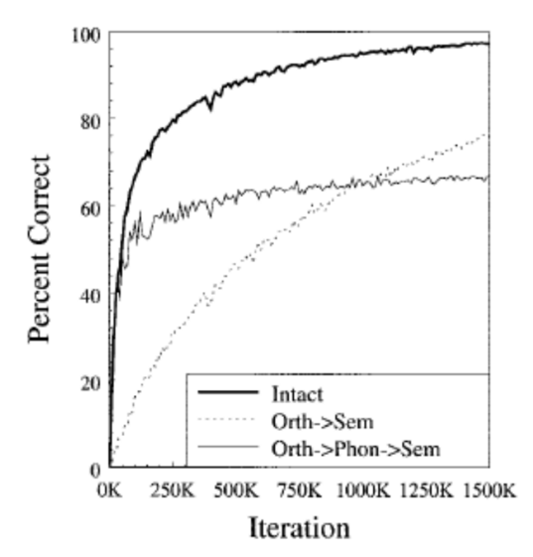
English reading
Background | My Research | Motivation | Algorithm | Thoughts
Cooperative division of labor
Depends on ease of computation on each route
Neither route is perfect
Orthography | Phonology
≈ The written form of a language | ≈ The sound system of a language
Harm and Seidenberg (2004)

Slide 7
Finding a universal model
Background | My Research | Motivation | Algorithm | Thoughts
English
Chinese
Written
DOG
Written
狗
D
O
G
Graphemes
狗
Graphemes
Pron.
d
ɔ
g
Mandarin
koʊ꜕꜖꜒
}
Cantonese
kɐu꜕꜒
Shanghai
kø꜔꜓
Concept
Wenzhou
kʰau꜔꜓
Pron.
Concept

Slide 8
Encoded information: Phono-semantic compounds
Background | My Research | Motivation | Algorithm | Thoughts
摸
mō “to feel”
镆
mò “sword”
Two indicators/radicals
Sub-character phonology
Imperfect
Inconsistent
扌hand
莫 mò
钅metal
莫 mò

Slide 9
Why compare these?
Background | My Research | Motivation | Algorithm | Thoughts
English
Chinese
Computation of phonology from written form
Does phonology mediate meaning?
Mixed evidence for sub-character phonology
Directly encodes meaning information
Both languages
Relative activation of semantics by written form and phonological form
“Division of labor”

Slide 10
Research
Background | My Research | Motivation | Algorithm | Thoughts

Slide 11
Current research
Background | My Research | Motivation | Algorithm | Thoughts
Different methods find different processing times
Debate over the use of the retrieved phonological information
Examine the specific role of phonology in word recognition
Functionally isolate routes
Agreement about phonological activation…
…but disagreement about its role

Slide 12
Background | My Research | Motivation | Algorithm | Thoughts
+
The
boy eat
house ran
The | boy | house | very | far | jump | school
 | eat | ran | car | blue | after | read

Slide 13
SHE
###

Slide 14
RAN
DOG

Slide 15
BED
FOR

Slide 16
SEVEN
JUMP

Slide 17
MILES
POUNDS

Slide 18
Critical manipulation
Background | My Research | Motivation | Algorithm | Thoughts
Orthographically similar / Phonological dissimilar
水 永
shuǐ
yǒng
English illustration:
beach bench

Slide 19
Critical manipulation
Background | My Research | Motivation | Algorithm | Thoughts
Orthographically similar / Phonological dissimilar
水 永
shuǐ
yǒng
English illustration:
bench
beach

Slide 20
The
###

Slide 21
man
sit

Slide 22
red
dug

Slide 23
in
of

Slide 24
the
out

Slide 25
sail
soil

Slide 26
Motivation
Background | My Research | Motivation | Algorithm | Thoughts

Slide 27
Quantifying Visual Similarity
Background | My Research | Motivation | Algorithm | Thoughts
A few different methods used in past
Most common:
Same radical
Same number of strokes

Slide 28
An imperfect method
Background | My Research | Motivation | Algorithm | Thoughts
Radical: 立
Characters containing this radical (w/ 9 strokes):
亲 竑 竓
竕 飒 竖

Slide 29
An imperfect method
Background | My Research | Motivation | Algorithm | Thoughts
Radical: 立
Good pairs:
竑-飒
竕-竑
Bad pairs:
亲-竕
竑-竖

Slide 30
Background | My Research | Motivation | Algorithm | Thoughts
食
9 strokes
EAT
9 strokes???

Slide 31
Hierarchical structure
Background | My Research | Motivation | Algorithm | Thoughts
你好!
你
好
亻
尔
女
子
⺈
小

Slide 32
Ideographic Description Characters
Background | My Research | Motivation | Algorithm | Thoughts
Unicode range U+2FF0 to U+2FFB
Intended to act as a rough description of characters

Slide 33
Background | My Research | Motivation | Algorithm | Thoughts
⿰ | left to right | ⿶ | surround from below
⿱ | above to below | ⿷ | surround from left
⿲ | left to middle and right | ⿸ | surround from upper left
⿳ | above to middle and below | ⿹ | surround from upper right
⿴ | full surround | ⿺ | surround from lower left
⿵ | surround from above | ⿻ | overlaid

Slide 34
Ideographic Description Language
Background | My Research | Motivation | Algorithm | Thoughts
你 | → | ⿰⺅尔
尔 | → | ⿱⺈小
兹 | → | ⿱䒑⿰幺幺

Slide 35
Algorithm
Background | My Research | Motivation | Algorithm | Thoughts

Slide 36
Parsing IDS BNF
Background | My Research | Motivation | Algorithm | Thoughts
char :: all valid CJK
binary :: 2FF0 |2FF1| 2FF4..2FFB
ternary :: 2FF2 |2FF3
sub :: tergroup|bigroup|char
bigroup :: binary sub sub
tergroup :: ternary sub sub sub
expr :: [ sub ]+

Slide 37
Background | My Research | Motivation | Algorithm | Thoughts
>>> import idsparser as ids
>>> ids.parse('丽', '⿱一⿰⿵冂丶⿵冂丶')
['丽', ['⿱', ['一', ['⿰', [['⿵', ['冂', '丶']], ['⿵', ['冂', '丶']]]]]]]
>>> ids.pretty_parse('丽', '⿱一⿰⿵冂丶⿵冂丶')
丽
└---⿱
└---一
└---⿰
└---⿵
└---冂
└---丶
└---⿵
└---冂
└---丶

Slide 38
Similarity algorithm
Background | My Research | Motivation | Algorithm | Thoughts
Tree generation
Structural weighting
Root comparison
Comparison reuse

Slide 39
Tree generation
Background | My Research | Motivation | Algorithm | Thoughts
class IDSTree():
def __init__(self, parse_tree, dictionary=None):
self.head = parse_tree[0]
self.ids = idsparser.unparse(parse_tree[1])
self.tree = IDSNode(parse_tree[1], self._dict)
self._dict = dictionary
if self._dict:
self._dict._nodes[self.head] = self.tree
self._dict._nodes[self.ids] = self.tree

Slide 40
Tree generation
Background | My Research | Motivation | Algorithm | Thoughts
class IDSNode():
def __init__(self, parse_tree, dictionary=None):
self.head = None
self.ids = None
self.children = None
self._dict = dictionary

Slide 41
Tree generation
Background | My Research | Motivation | Algorithm | Thoughts
If head of parse tree is IDS functor:
Assign functor to self.head
Assign flat sequence to self.ids
Assign tree children to self.children list as recursive IDSNodes
If head of parse tree is not functor:
Leaf has been reached
Assign character to self.head
Assign character to self.ids

Slide 42
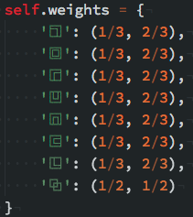
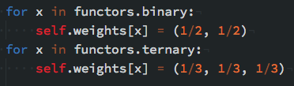
Structural weighting
Background | My Research | Motivation | Algorithm | Thoughts

Slide 43
Root comparison
Background | My Research | Motivation | Algorithm | Thoughts
def compare_nodes(a, b):
If a is b... #same tree
If a.head == b.head...
If a.head not in functors
and b.head not in functors
Else recursive comparison
If a.head != b.head...

Slide 44
Comparison reuse
Background | My Research | Motivation | Algorithm | Thoughts
class IDSTree():
def __init__(self, parse_tree, dictionary=None):
self.head = parse_tree[0]
self.ids = idsparser.unparse(parse_tree[1])
self.tree = IDSNode(parse_tree[1], self._dict)
self._dict = dictionary
if self._dict:
self._dict._nodes[self.head] = self.tree
self._dict._nodes[self.ids] = self.tree

Slide 45
Tweaking the algorithm
Background | My Research | Motivation | Algorithm | Thoughts
Pure structural weighting resulting in many leaves with 0 similarity
Radical similarity account for 1/3 of similarity
Stroke proportion accounts for 1/3 of similarity

Slide 46
Examples
Background | My Research | Motivation | Algorithm | Thoughts
Before change:
水 永
0%
After change:
水 永
75%

Slide 47
Distributed processing
Background | My Research | Motivation | Algorithm | Thoughts
Many individual cloud servers
Elasticsearch database storing IDS comparisons
2000 chars = 1999000 comparisons
5000 chars = 12497500 comparisons
At 10ms per comparison, 34 hours

Slide 48
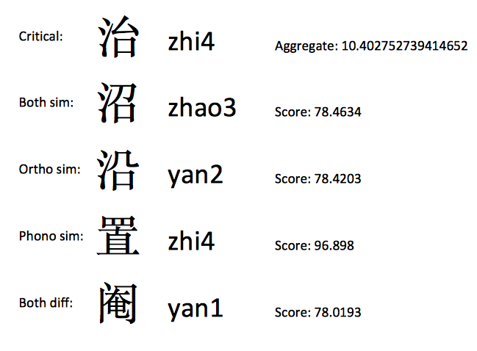
Creating critical sets
Background | My Research | Motivation | Algorithm | Thoughts
Pandas dataframe
Sort by ortho sim, phono sim

Slide 49
Thoughts
Background | My Research | Motivation | Algorithm | Thoughts

Slide 50
Python in Academia
Background | My Research | Motivation | Algorithm | Thoughts
Why Python?
Easy to experiment
Lots of flexibility
Plan of attack isn’t always clear when exploring a new idea

Slide 51
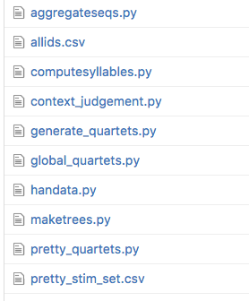
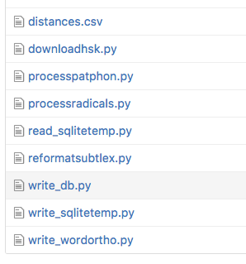
Python in Academia
Background | My Research | Motivation | Algorithm | Thoughts

Slide 52
Why do things programmatically?
Background | My Research | Motivation | Algorithm | Thoughts
Reproducibility!
A digital trail exists for all tools in the experiment design pipeline
Flexibility!
A small change in the pipeline doesn’t require starting from scratch

Slide 53
Take away message
Background | My Research | Motivation | Algorithm | Thoughts
Python can be used to explore new solutions to old problems
Easily enables experimentation
Tools exist for every sub-problem!

